Slide 1
Nutrition of Palestinian School Children: A Double-Burden Situation
The 4th Arab Conference on Nutrition
Salwa Massad, PhD
Juzoor for Health and Social Development &
United Nations Relief and Works Agency for Palestine Refugees in the Near East(UNRWA)
April, 7th 2011

Slide 2
Background
Population : 4.1 millions; 2.5 WB and 1.6 Gaza
Median age at marriage 19 in WB, 18 in Gaza.¹
Since start of ‘intifada’ 2000, increasing poverty, unemployment and hardship. In 2002, 58% of households in WB and 54% in Gaza have lost over half their usual income since before the Intifada.²
Dietary intake deteriorated both in terms of quantity and quality, 50% completely dependent on food aid.³
Since 2002, construction of Annexation Wall, further restrictions on freedom of movement, worsening economic conditions that seriously compromised household welfare and access to care (42% WB, 32% Gaza)⁴
¹PCBS. Population, Housing and Establishment Census, 2007. 2008.
²World Bank 2002
³ Alquds University 2004 ^{4:} PCBS 2003

Slide 3
Background- cont.
In 2009, 57% below poverty line, 24% in deep poverty, 25% unemployed¹
38% Palestinian population are food insecure. Land confiscation and destruction of crops contributes to food insecurity.²
Food insufficiency is a serious problem affecting children’s ability to learn.³
¹ PCBS 2004. ON the Eve of the International Population Day
²FAO/WFP, 2009. Occupied Palestinian Territory. Food Security and Vulnerability Analysis Report.
³ Wesness K, et.al. Appetite, 41 (3):329-31.2003

Slide 4
Background- cont.
In 2003, 38% children<5 anemic, ¹ while 58% of refugees 6-36 months were anemic²
Rate of stunting in children <5 years has risen from 7% in 1996 to 10% in 2006.³
In 2005, a study⁴ was carried out among
366 children 3-7y living in Hebron and Gaza,
15-20% anemia, 25-40% low serum ferritin
50% B12 deficiency, 25-30% Zinc deficiency
^{1 PCBS, Nutrition Survey 2003}
^{2: MOH 2004}
³ PCBS. Population, Housing and Establishment Census, 2007. 2008.
4 Allen Lindsay. Nutritional Status in Gaza city and Hebron. USDA, ARS Western Human Nutrition Research Center. University of California, Davis.

Slide 5
Background- cont.
Rising in obesity, diabetes and cardiovascular disease.¹
Absence of a national school meal program
Absence of systematic nutritional education at the schools
Poor nutritional value of the food offered by most school cafeterias
²Huseine et.al. Lancet 2009.

Slide 6
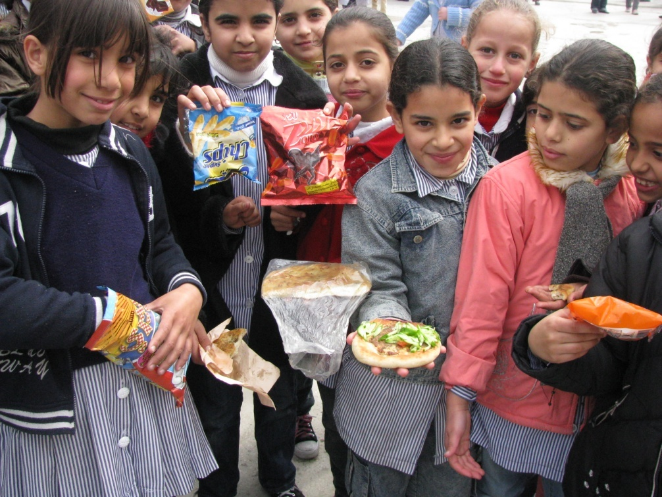

Slide 7
Study Team
This research was carried out in 2009 by UNRWA, in collaboration with:
Juzoor Foundation for Health & Social Development
Columbia University
Ministry of Higher Education/School Health Division.

Slide 8
Overall Objectives
Provide a picture of nutritional status in sample of school children in West Bank
Examine factors contributing to anemia among school children.
Help assess the impact of the health/nutritional interventions that are running in Palestinian communities.
Identify key blood and biochemical parameters to incorporate in a surveillance system.
Offer evidence-base information to direct policies and nutritional interventions.

Slide 9
Study Design
School-based cross- sectional survey 2009.
22 UNRWA and Government schools covering the North, Central and South regions of the West Bank
42 students randomly selected from each of 1st, 6th, and 9th grades.
1485 students: 50% female.

Slide 10
Procedure
The study was introduced at information sessions for the school community (teachers, parents, and students), held with participation of local community physicians.
Informed consent and assent forms were obtained from students, parents and teachers following Columbia University guidelines.

Slide 11
Procedure
Anthropometric measures
Venous blood sample.
Complete blood cell count
C-Reactive Protein (CRP)
Ferritin and Serum Zinc
Serum vitamin B12 and folate
Thyroid Hormones: FT3, FT4, TSH
Blood lead level in 50% of sample.

Slide 12
Quality Control
Field manager took the standing height and weight for all participants to avoid inter-observer bias. Measurements taken twice. If difference between the 2 measurements >10%, a third measurement was taken.
Central lab ran all the tests. Standardized methods, and using external validity through CDC, in addition to internal validation methods.

Slide 13
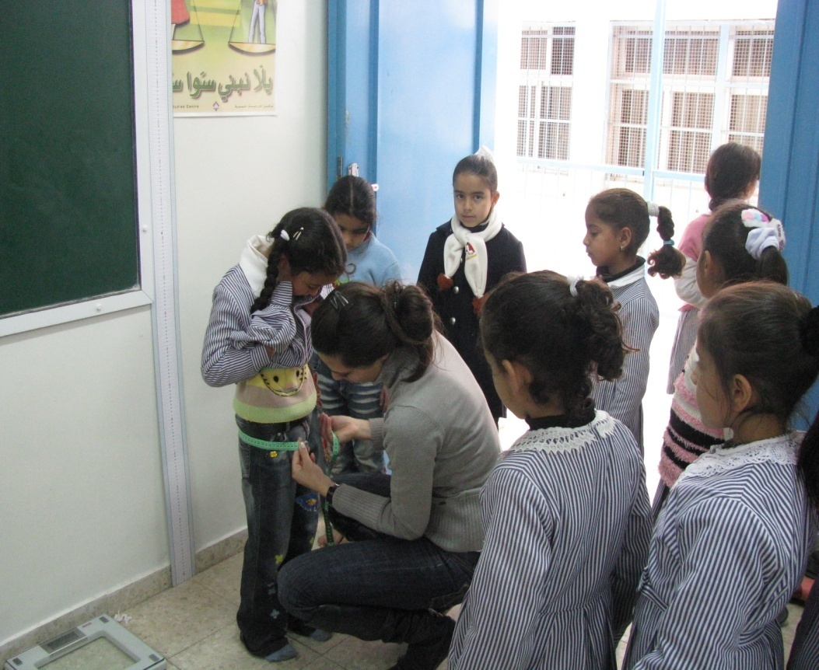

Slide 14
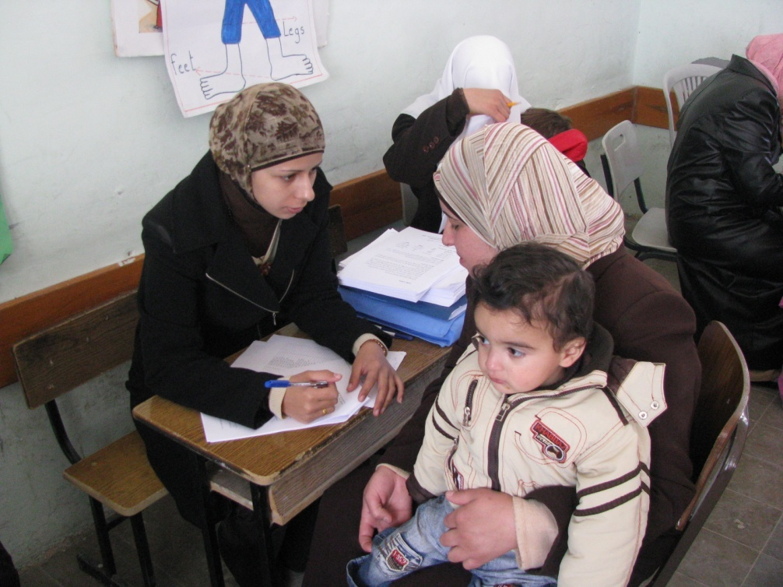

Slide 15
Response Rates
Blood: 1475/1500 (98% ),
Surveys: (Student): 99%
(Parent): 84%
(Teacher): 100%

Slide 16
Prevalence of Underweight (5th percentile), Overweight (85th) and Obesity (95th)
3.3% of the study sample were underweight,
12.4% were overweight and
5.9% were obese.

Slide 17
Prevalence of Underweight ,Overweight and Obesity by Grade and Gender

Slide 18
Factors associated with underweight
Factors associated with underweight were male gender
(OR =2.8, 95% (CI): 1.5, 5.3),
mother’s unemployment
(OR=3.0, 95% C 1.04-8.38) and
household did not have enough food at least 2 days in the past month
(OR=1.8, 95% CI: 1, 3.3).

Slide 19
Trend in BMI with increased grade

Slide 20
Trend in Obesity with increased Grade

Slide 21
Factors associated with overweight and weight
Factors associated with obesity were child grade; higher grades were more likely to be obese (p=0.01), and watching more television was associated with a higher likelihood of obesity (p=0.02).
Combining overweight and obesity, the only significant factor associated with both was sports; more days/week the students engaged in sports, the less likely they were to be overweight or obese (p=0.02).

Slide 22
Stunting
Mean HAZ (SD): -0.57 (1.03)
6.7% of the study sample were stunted
(HAZ<-2)
Insignificant gender differences:
6.5% males, 6.9% females
Insignificant grade differences: 6.6% First, 8.0% Sixth, 5.5% Ninth

Slide 23
Factors associated with Stunting
The only factor associated with HAZ was the hunger index which was negatively associated with HAZ (p= 0.018).
Items hunger index: ran out of money to buy food, relied on a limited number of foods, cut the size of meals or skip any, ate less because there was not enough money for food, children ate less than they should because as there was not enough money for food, children complained of hunger, cut the size of the children’s meals or skipped meals, the children went to bed hungry at least once.

Slide 24
Summary of Anthropometric measures
3.3% of the study sample were underweight, 12.4% were overweight and 5.9% were obese.
6.7% of the study sample were stunted
Main nutritional problems in all grades and in both males and females were overweight and obesity.
Stunting, overweight and obesity coexist in first and sixth graders.
Stunting and underweight coexist with overweight and obesity in ninth grade males
Notes:
الخلاصةو التوصيات

Slide 25
Defining Anemia & ID
Source: WHO 2001 (WHO/NHD/01.3)
Serum ferritin cut point 15 ng/ml
Low MCV cut point 75
Gender | Age (years) | Hb (g/dl)
Both | 5-12 | 11.5
Both | 12-15 | 12
Females | >= 15 | 12
Males | >= 15 | 13

Slide 26
Prevalence of Anemia
Prevalence of anemia 9.4%
Significant gender differences :
12.1% Females, 7.1% Males (p=0.001)
Insignificant differences by grade level:
First: 8.9%
Sixth: 8.0%
Ninth: 12.1%
The Anemia among male schoolchildren was 27.8% (8.6% in WB and 55.3% in GS) (Nutrition survey 2011, MOH).

Slide 27
Prevalence of iron deficiency
Prevalence of ID 22.7%
Significant gender differences :
29.5% Females, 15.7% Males (p=0.00)
Significant differences by grade level:
First: 19.7%
Sixth: 18.7%
Ninth: 29.9% (p=0.00)

Slide 28
Prevalence of Anemia and ID by Grade and Gender

Slide 29
Summary of Anemia:
9.4% of the study sample were anemic.
42.0% of those with anemia had low serum ferritin (< 15 µg/L)
18.8% of the sample had low MCV (< 75FL)
22.7% had low serum ferritin (<15 µg/L); and 23.2% when excluded those with elevated CRP (> 11 mg/L).
2.6% of the entire sample had elevated CRP

Slide 30
Low Serum Zinc (< 65 µg/dL)* by District and Gender
31.3% of the study sample had Zinc deficiency
Significant gender differences:
29.1% Males, 33.5% Females (p=0.04)
Significant age differences in Zinc deficiency:
First grade: 35.2%
Sixth grade: 32.9%
Ninth grade: 25.6%
(p=0.003)

Slide 31
B12 Deficient (<221 pg/ml)and Marginal (< 300 pg/mL)
22% children have vitamin B12 deficiency and 40% more show a marginal status
Significant gender differences in B12 deficiency: 24.0% Males, 20.1% Females (p=0.04)
Significant grade differences:
First: 14.7%
Sixth: 24.3%
Ninth: 27.4% (p=0.00)

Slide 32
B12 Deficient (<221 pg/ml)and Marginal (< 300 pg/mL)

Slide 33
Serum Folate
0.1% : <3.1 µg/L (Megaloblastic anemia)
2.3% : <7.0 µg/L (NTD’s risk)
72.3%: 7-20 µg/L (Normal)
25.1% : >20 µg/L (Supra-physiological)

Slide 34
Low Serum Folate (<7.0 µg/L )
Insignificant gender differences:
3.0% Females, 1.8% Males
Significant grade differences:
First : 1.4%
Sixth: 1.4%
Ninth: 4.4% (p=0.002)

Slide 35
Low Serum Folate by Grade and Gender

Slide 36
Prevalence of Low FT3,FT4 and High TSH
Thyroid Hormones:
0.2% had low FT3 (FT3< 2.3 pg/mL)
8.2% had low FT4 (FT4< 0.89 ng/dL)
3.6% had high TSH (TSH> 5.5 uIU/mL)

Slide 37
Lead Toxicity
There were no cases of lead toxicity in the studied sample.

Slide 38
Conclusions-1
Children start school with low obesity but by the 9th grade overweight and obesity (∼ 24% ) start to be observed, mainly in women.
Although overweight and obesity are more widespread problem than stunting and underweight, under-nutrition is an urgent health priority.
Anemia is mild in school-age children of the West Bank, although prevalence increases in women after the 6th grade. Half of the anemia is explained as iron deficiency.

Slide 39
Conclusions-2
Although anemia prevalence is low, ID continues affecting around 20% of the studied population.
30% children present low serum zinc levels
22% children have vitamin B12 deficiency and 40% more show a marginal status.
Based on logistic regression, factors associated with anemia were female gender (OR: 1.6 (1.1, 2.2),
ID (OR: 2.5 (1.7,3.6), and
Low Zinc (OR: 1.6 (1.1, 2.2).
*B12 deficiency was not associated with anemia in our sample.

Slide 40
Conclusions-3
25% children show supra-physiological levels of serum folate, which suggest a plausible association with intake of fortified wheat flour. Levels of thyroid hormones point out that iodine deficiency is under control in the West Bank (91% iodized salt^{)1.}
Lead contamination was not identified in the studied population.
While deficiencies of iron, zinc and vitamin B-12; folate intake is in the high side; and iodine status is fine.
¹ ^{PCBS 2011}
Notes:
التي تشير الى ارتباط معقول مع كمية من دقيق القمح المدعم.

Slide 41
Conclusions-4
In summary, current situation points out that the main nutritional risks for school-age children in the West Bank are overweight and obesity, combined
The results suggest that salt iodization and wheat flour fortification are influencing the micronutrient status of the Palestinian population. However, some micronutrients are still required in larger amounts (iron, zinc, vitamin B-12, e.g.), either by increasing the fortification levels or by using complementary measures combined with health education.
Notes:
وباختصار ، فإن الوضع الحالي يشير إلى أن المخاطر الرئيسية التغذوية للأطفال في سن الالتحاق بالمدارس في الضفة الغربية يعانون من زيادة الوزن والبدانة، جنبا إلى جنب
وتشير النتائج إلى أن إضافة اليود إلى الملح وإغناء الدقيق القمح والتأثير على الوضع الغذائي للسكان الفلسطينيين
ومع ذلك، لا تزال هناك حاجة بعض المغذيات الدقيقة في كميات أكبر (الحديد والزنك، وفيتامين ب 12، على سبيل المثال)، إما عن طريق زيادة مستويات التحصين أو باستخدام تدابير تكميلية

Slide 42
Research Team
Salwa Massad¹
Umaiyeh Khammash² Richard J. Deckelbaum³
Mysoon Obeidi ² Paula Bordelois³
Steve Holleran³
^{Consultants}
Omar Dary⁴
Medhin-Mahari⁵
^{1: Juzoor Foundation} for Health and Social Development
^{2: UNRWA}
3: Institute of Human Nutrition/Columbia University
4: A2Z/the USAID Micronutrient Project, Washington, DC, USA
5. Department of Women's and Children's Health, Pediatrics, Uppsala University

Slide 43
Acknowledgement
We are grateful for all participants, school health officers and school principles and field workers.
Grateful for UNRWA Chief Education Officer and Director of School Health Division/MOHE for all their help and support
This study was supported by
UNRWA,
UNICEF,
Juzoor and
Palestinian Health Sector Reform and Development Project (the Flagship project)
Notes:
ونحن ممتنون لجميع المشاركين، وضباط الصحة المدرسية ومبادئ المدرسة والعاملين الميدانيين
الاستماع
قراءة صوتية للكلمات
القاموس - عرض القاموس المفصل
اسم
ضبط الجودة
وأيد هذه الدراسة من أموال من

